Slide 1
Descriptive analysis of Twitter data
BASTA Mohammed
JAOUIRI Younes
MODULE : Statistics for data science
MASTER : Data science
UNIVERSITY : Cadi Ayyad Marrakech
Notes:
La durée totale de la présentation ne doit pas dépasser 15 minutes, une fois le délai dépassé la présentation sera interrompu

Slide 2
Plan
Analyze the structure of tweets
Complete the data
Import data to the database
Process data
Extract information
Show the results

Slide 3
Analyze the structure of tweets
To do the treatment on tweets you must first know their structures. We chose to limit our study to the following attributes (as needed):
The date and time of the tweet.
The code of the tweet.
The content of the tweet.

Slide 4



Analyze the structure of tweets
The information corresponding to the user who tweeted, among them: His identifier, his name and Its location
The information corresponding to the location of the tweet (just): The country and The country code
The attribute that defines the language of the tweet

Slide 5

Complete the data
The data is supplemented by the call of APIs such as: To determine: -the geographical area, -opinion, -the location and -the gender.
: The geographical region

Slide 6



Compléter les données (2)
: opinion (sentiment)
: Localisation
: gender

Slide 7
Import data to the database
In order to improve the performance and increase the speed of the treatment it was ideal to use a structured database instead of making direct and daily access to the file "HumanRights" (large file). SQLite data base allowed us to facilitate the sending of requests and gave us the possibility to move the project to another machine without any problem (MySQL requires a server). Columns have been added to the table to facilitate several features.

Slide 8
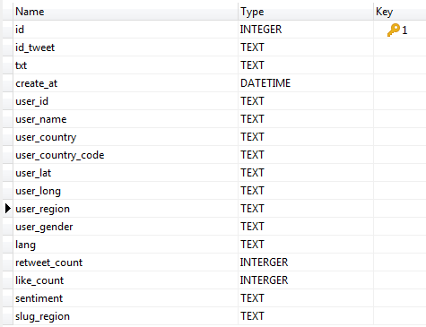
Import data to the database

Slide 9

Process data
the data processing is done by Pandas. use of functions for returning results each function addresses a question by its own approach using a custom API to transfer data the list of processing functions:

Slide 10
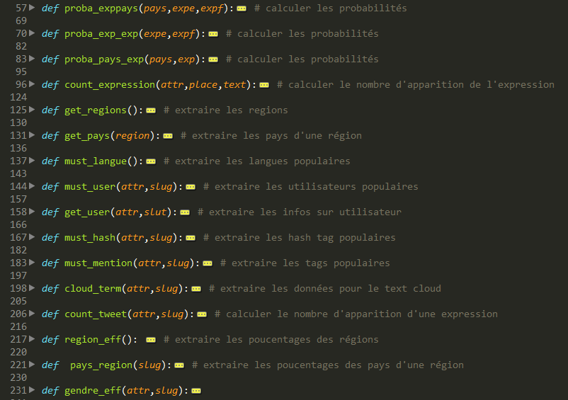
Process data

Slide 11
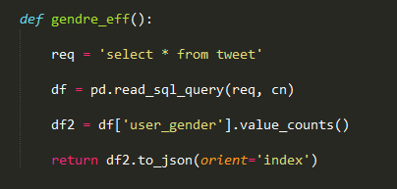
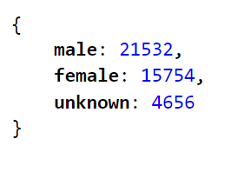
Process data
Example of a function: workforce by gender
Where cn (connection to the database) is:
Statistique JAOUIRI Younes - BASTA Mohammed

Slide 12
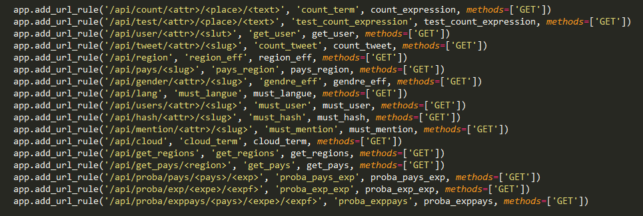
Extract information
The display of results is done through a web interface, hence the use of creating an API that allows us to link pandas and display (sending requests and responses).

Slide 13


Afficher les résultats
the use of a flask python micro-framework the use of JQuery to boost our site PS: FLASK is also used for the creation of the API

Slide 14
DEMO

